Slide 1

8-Bit ALU Implementation Using FPGA
Team Members
Bishant Adhikari (BEI 75007)
Lucky Prajjwal Shrestha (BEI 75010)
Neetika Aryal (BEI 75013)

Slide 2
Overview
Introduction
Problem Statement
Objectives
Applications
Hardware Components
Simulation Works

Slide 3
Introduction
01
The project describes the realization of an 8-bit FPGA based simple processor (ALU).
02
The implementation of most basic digital circuit, ALU, using a single FPGA development board .
03
An arithmetic and logic unit (ALU) is one of the most important component in a microprocessor.

Slide 4
Arithmetic And Logical Unit
01
A digital circuit used to perform arithmetic and logic operations.
02
Modern CPUs contain very powerful and complex ALUs. In addition to ALUs, CPUs contain control unit and memory unit. .
03
ADD , SUB , MUL are some arithmetic operations. AND , OR, NAND, NOR are some logical operations.

Slide 5
Objectives
01
Design and Verify different operations of Arithmetic And Logic Unit
02
To Understand the basics of FPGAs and inner working of Microprocessors
Notes:
To introduce and normalize the use of FPGAs in the Neplease society

Slide 6
Application Of This Project
01
Can perform very fast mathematical operations parallelly for an application specific design, which otherwise conventional CPU designs can't handle.
02
Can use this ALU Design as a building block in various other projects .

Slide 7
Hardware Components

Slide 8
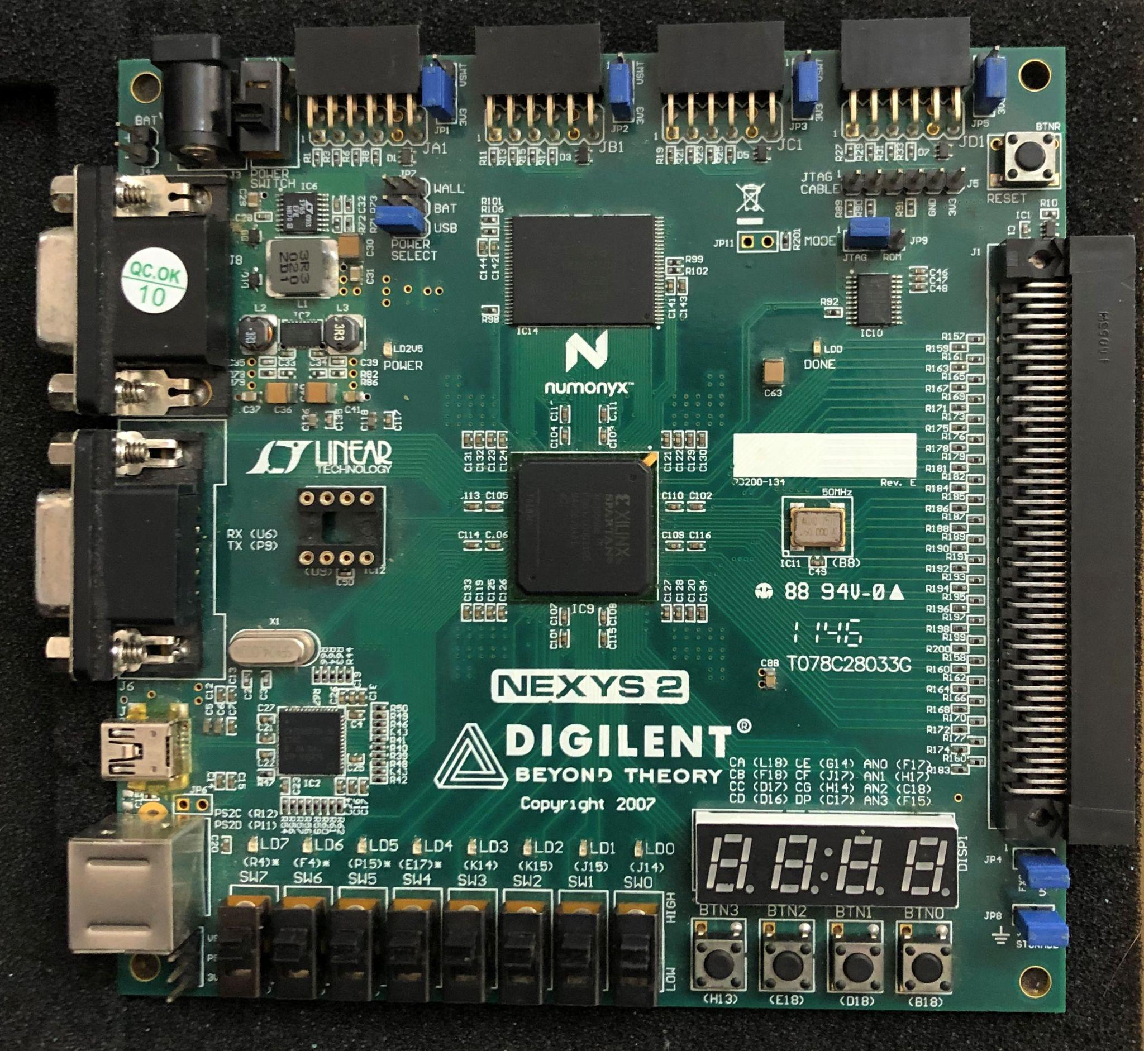
Field Programmable Gate Arrays (FPGA)
01
Semiconductor device based around a matrix of configurable logic blocks.
02
It Can be designed by Hardware Description languages like VHDL and verilog.
03
It Can be reprogrammed until the processor design is final.
Notes:
Structure of an FPGA
Configurable Logic Block (CLB) A CLB is the fundamental piece of an FPGA and is what gives it its ability to take on different hardware configurations. ...
Digital Signal Processing (DSP) Slice. ...
Transceivers. ...
Block Random Access Memory (BRAM) ...
Input/Output (IO) Blocks.

Slide 9
VHDL
01
The VHSIC Hardware Description Language (VHDL) is a hardware description language (HDL)
02
It can model the behavior and structure of digital systems at multiple levels of abstraction, ranging from the system level down to that of logic gates.

Slide 10
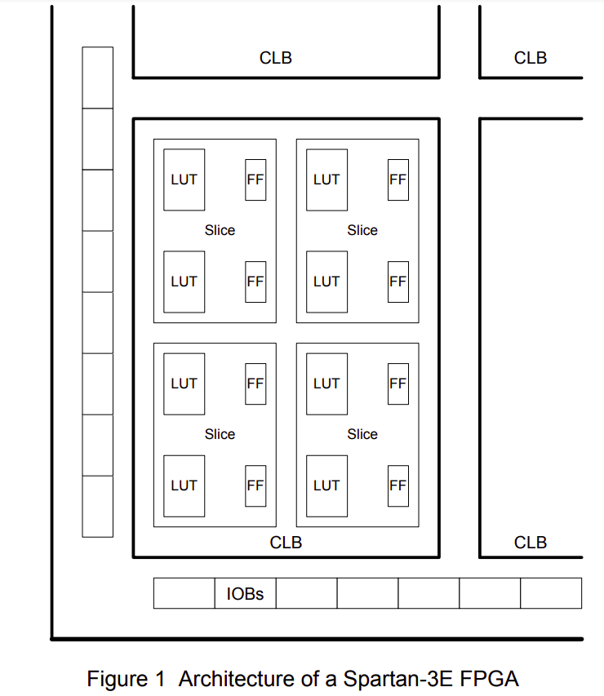
Architecture of Spartan-3E FPGA
01
We used Spartan 3E-500 FG320 FPGA on Nexys-2 board from Digilent.
02
Each CLB contains 4 slices, each of which contains two 16*1 RAM LUTs and two D flip-flops.
03
Each LUT can implement any combinational logic functions of 4 variables.
Notes:
Structure of an FPGA
Configurable Logic Block (CLB) A CLB is the fundamental piece of an FPGA and is what gives it its ability to take on different hardware configurations. ...
Digital Signal Processing (DSP) Slice. ...
Transceivers. ...
Block Random Access Memory (BRAM) ...
Input/Output (IO) Blocks.

Slide 11
Methodology

Slide 12
Project Flowchart
Create a project
Add files to the project
This is the basic project flowchart of our project.
Compile design files
Run simulation
Debug results

Slide 13
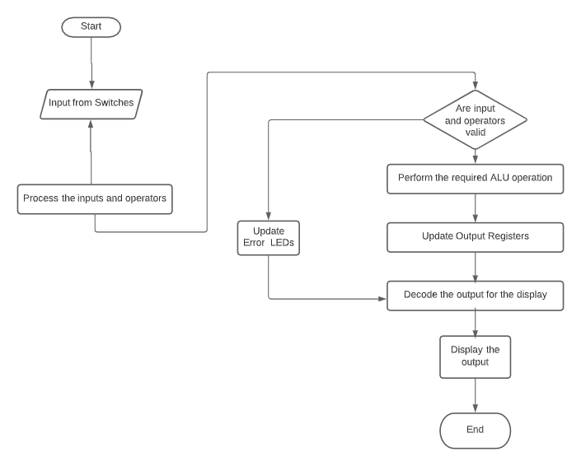
System Flowchart

Slide 14
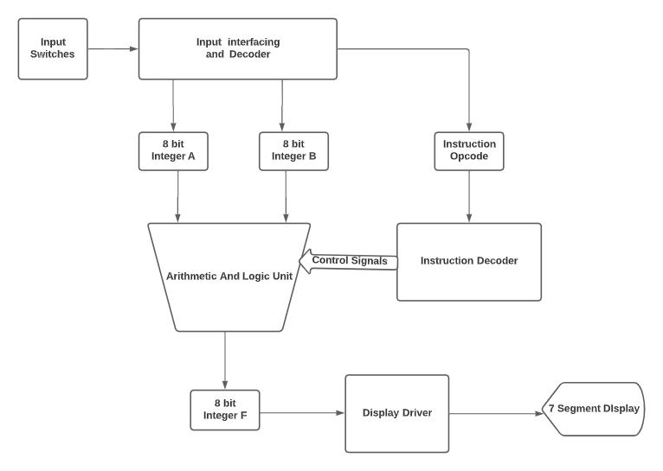
System Block Diagram

Slide 15
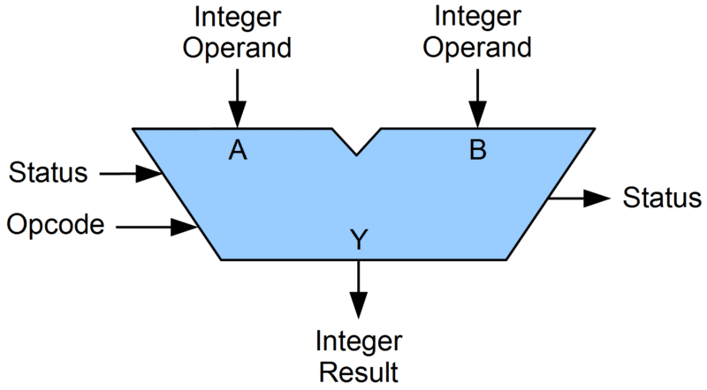
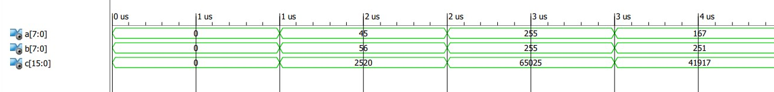
ALU block diagram

Slide 16
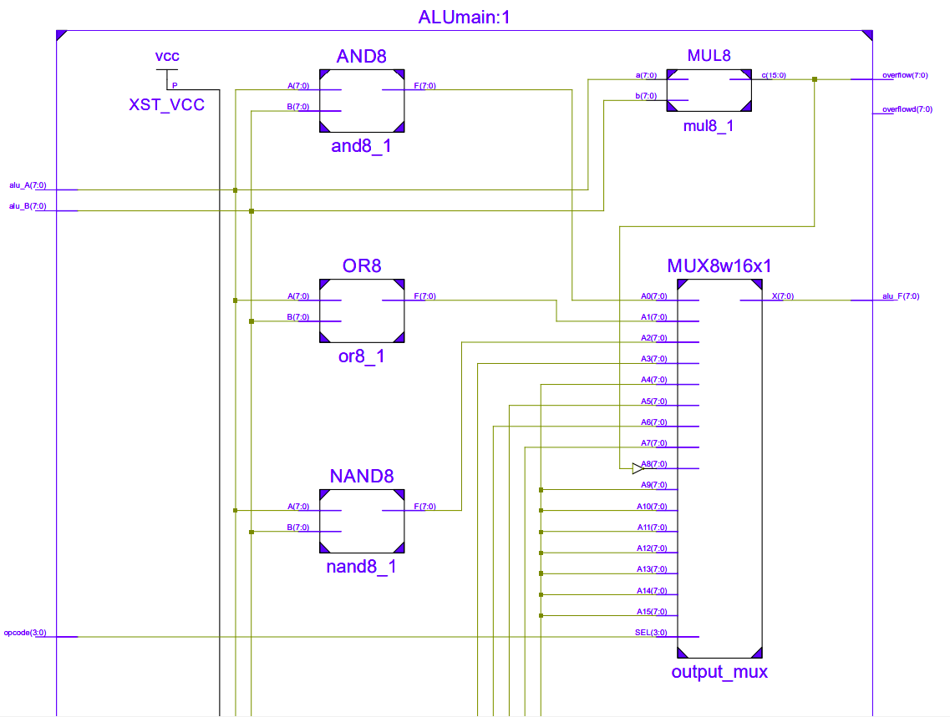
ALU

Slide 17
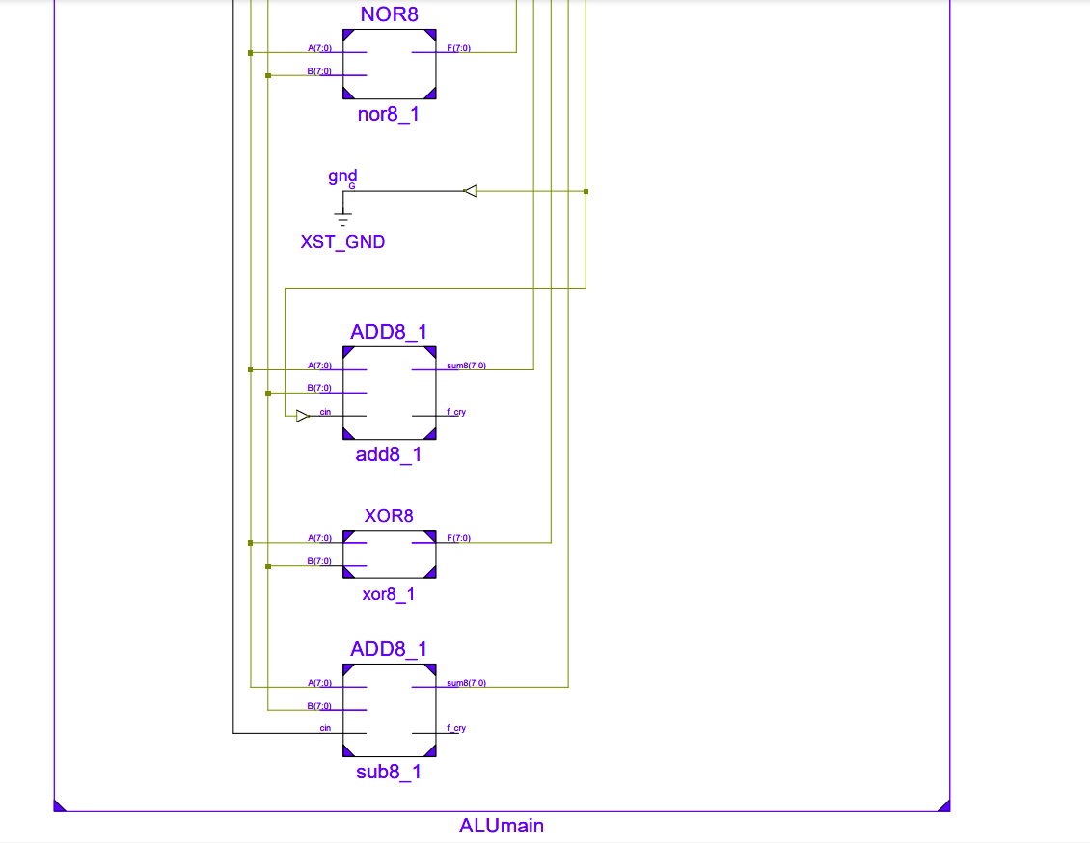
ALU

Slide 18
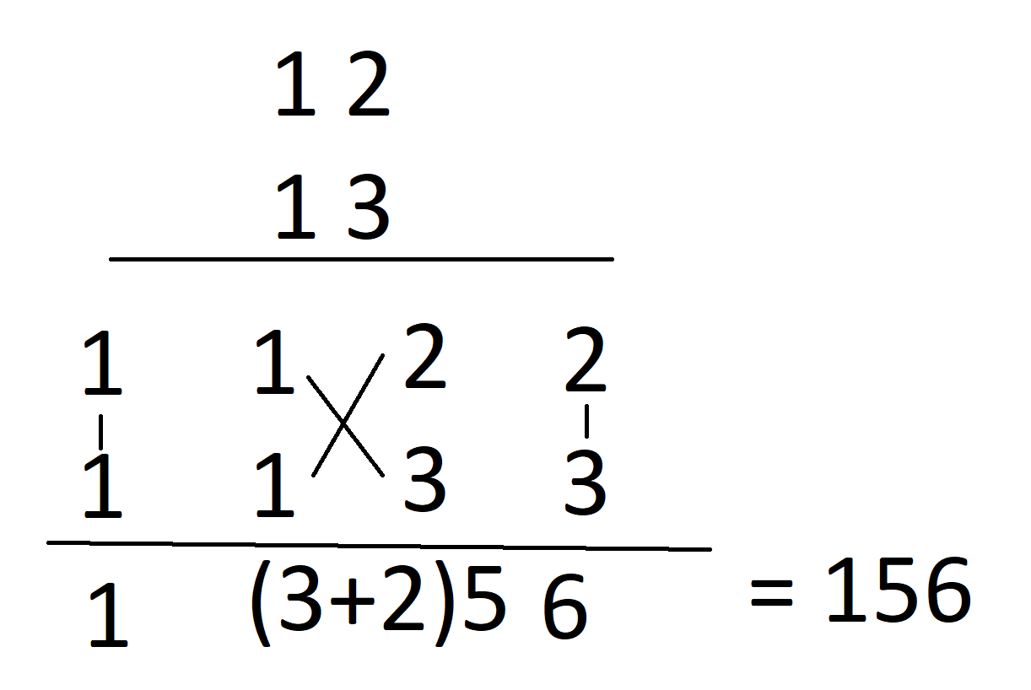
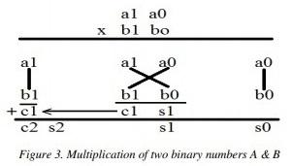
2x2 VEDIC MULTIPLIER
s0 = a0b0………………….. (1)
c1s1 = a1b0 + a0b1………... (2)
c2s2 = c1 + a1b1………….... (3)

Slide 19
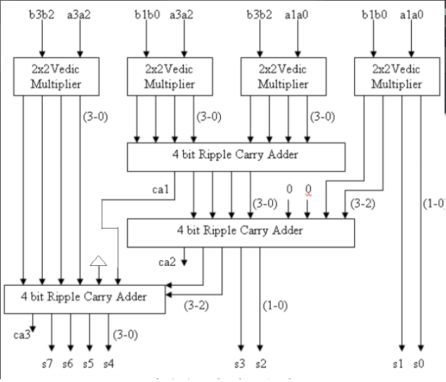
4X4 MATRIX
MULTIPLICATION

Slide 20
MATRIX MULTIPLICATION
01
Matrix multiplication is very important in fields like Computer Graphics and Machine Learning.
02
Multiplication algorithm is used to make a matrix multiplier
03
We have used a Python script to synthesize the VHDL code for general Matrix Multiplication of any shape

Slide 21
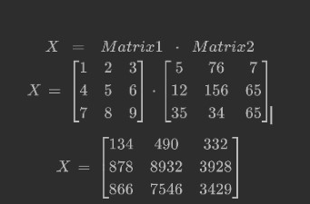
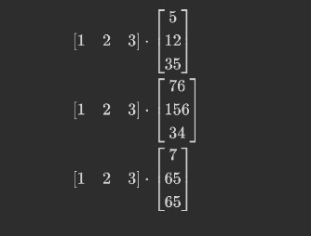
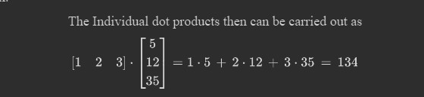

Slide 22
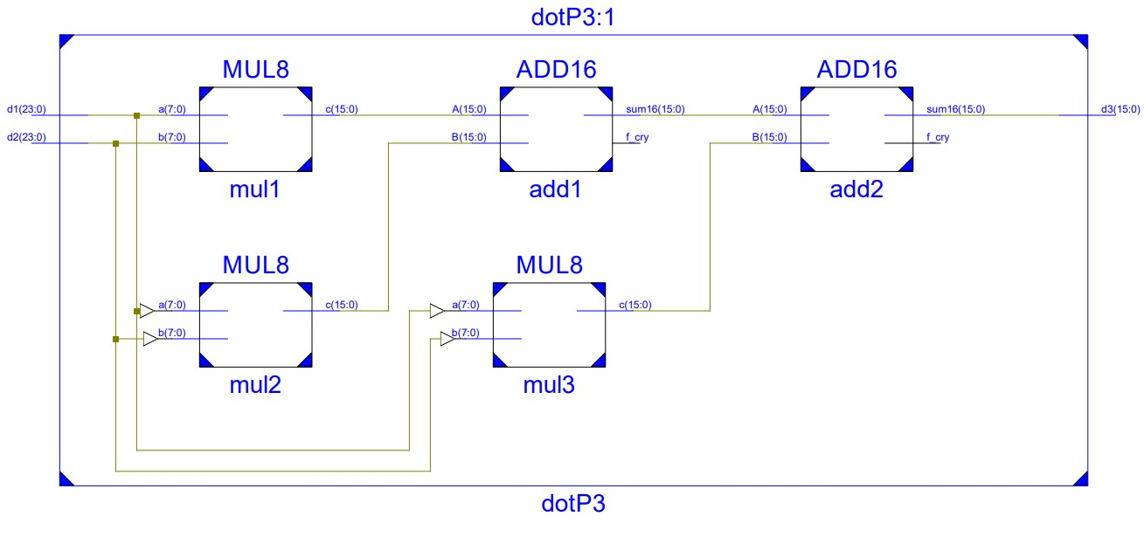
MATRIX
MULTIPLICATION
-Dot Product

Slide 23
Simulation Works

Slide 24
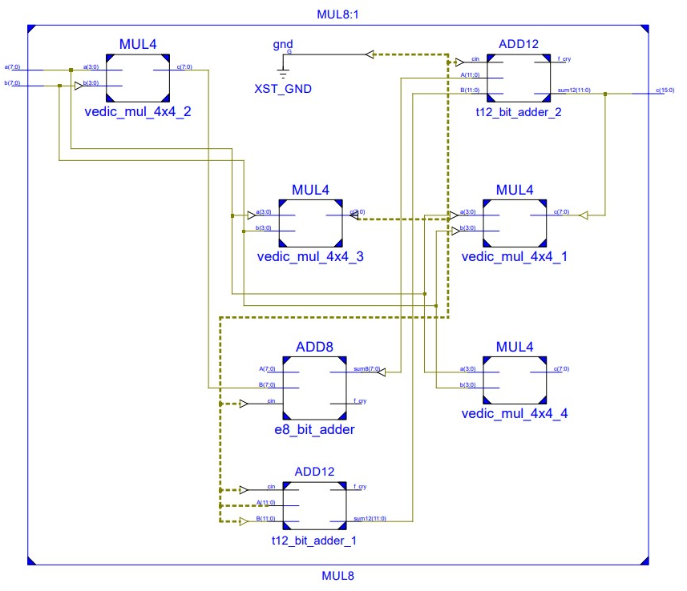
8-bit MULTIPLICATION

Slide 25
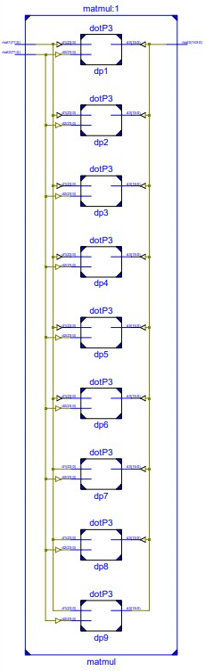
MATRIX
MULTIPLICATION

Slide 26
MATRIX
MULTIPLICATION
-Dot Product

Slide 27
8-bit MULTIPLICATION

Slide 28
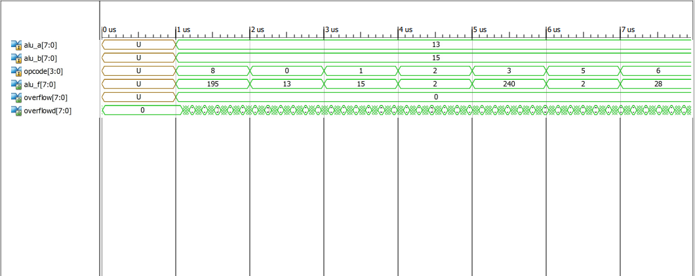
ALU timing diagram

Slide 29
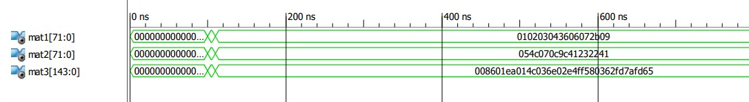
MATRIX MULTIPLICATION

Slide 30
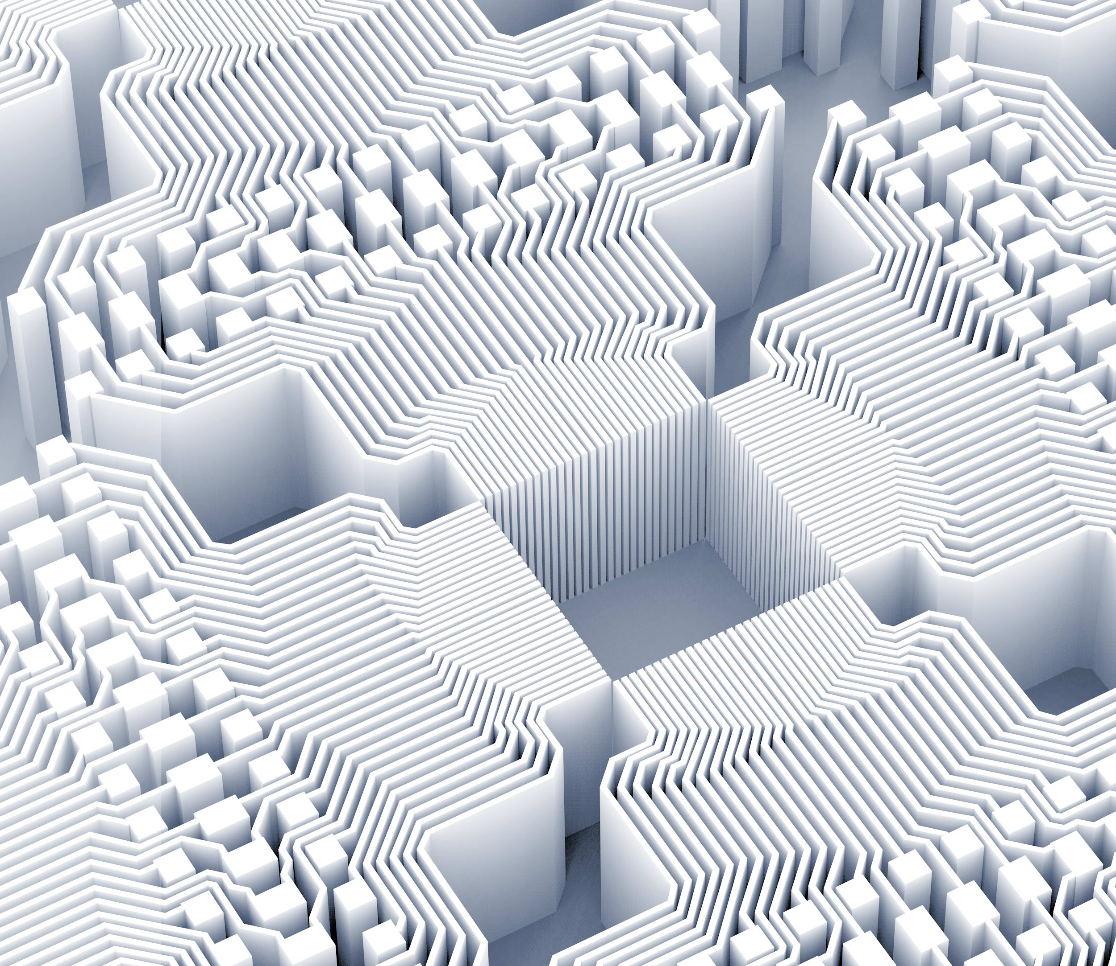
Thank you!

